Slide 1

DEPARTMENT OF INFORMATION TECHNOLOGY
UNIVERSITY COLLEGE OF ENGINEERING, SCIENCE & TECHNOLOGY
JAWAHARLAL NEHRU TECHNOLOGICAL UNIVERSITY HYDERABAD
KUKATPALLY, HYDERABAD, TELANGANA, INDIA-500085
A
MINI PROJECT
ON
ONLINE EXAM PROCTORING SYSTEM USING ARTIFICIAL INTELLIGENCE
Presented By:
ERRI SUVARNA
24011D2527
M.TECH(SE)

Slide 2
ABSTRACT
This project presents an Artificial Intelligence(AI) -based Online Exam Proctoring System designed to ensure fairness in remote assessments. Developed using Python Flask, MediaPipe, OpenCV, and YOLOv5. The system monitors students in real-time via webcam.
It detects suspicious activities such as:
Tracking(mouth movements),Frequent eye blinking, Unusual head movements, Presence of unauthorized objects
It automatically logs violations. After repeated offenses, the system can terminate the exam automatically. This reduces the need for human invigilators. Enhances the integrity of online exams.
Keywords: Online Proctoring, AI-based Monitoring, Remote Exam, YOLOv5, MediaPipe, Face Detection, Flask Web App.

Slide 3
INTRODUCTION
Overview
AI-based system to monitor online exams using real time webcam.
Extracts features like phone use, multiple persons visible and user verification.
Provides portals for both examinees and examiners.
Motivation
COVID-19 accelerated the shift to online education and exams.
Need for affordable, scalable, and effective online exam monitoring.
Problem Definition
Manual remote monitoring is not scalable and prone to cheating.
Requires software that works with built-in real time webcams.

Slide 4
LITERATURE SURVEY
S.NO | AUTHORS NAME | DESCRIPTION
1 | A. Mishra, R. Sen(2024) | Used Media Pipe + YOLOv8 for real-time cheating alerts via webcam. No exam UI or report system
2 | K. Singh, P. Mehta(2023) | Detected blinks and mouth movement using Media Pipe. Missed object detection, head pose, and exam integration.
3 | D. Patel, T. Kaur(2023) | Focused only on head pose detection. Lacked full exam link-up, blink/mouth/object tracking, and cheat logic.
4 | N. Joshi, A. Deshmukh(2022) | Built live webcam view with Flask + OpenCV. Missing cheating detection, count logic, questions, results, and report generation.
5 | L. Zhang, Y. Liu (2022) | Used YOLOv5 to detect phones in live video. No facial behavior tracking (blinks, mouth, head pose) or complete exam system.

Slide 5
EXISTING WORK
Traditional exams rely heavily on manual supervision (in-person or via webcams).
Manual monitoring is time-consuming, costly, and prone to human error.
Students can exploit simple systems by switching tabs or using unauthorized materials.
No real-time alerts or automated responses to suspicious behavior.
Current systems are not scalable for large exams and lack strong security protocols.
Overall, these systems are inefficient, expensive, vulnerable to cheating, and lack automation.

Slide 6
OPEN PROBLEMS OF EXISTING SYSTEM
Privacy concerns and data protection.
AI bias affecting fairness.
False positives/negatives in cheating detection.
Need to detect evolving cheating methods.
Balancing user experience and monitoring.
No unified admin-student exam portal.
No integration of AI models like YOLO + MediaPipe.
No live webcam view directly in the browser

Slide 7
PROPOSED WORK
How Proposed System Overcomes Existing System Limitations
Uses AI (blink, mouth, head pose, object detection) to monitor students via webcam.
Detects and flags suspicious behavior in real-time.
Automatically ends exam after 3 violations.
Shows live detection labels on screen.
Generates activity report for each student.
Stores data securely using SQLite and Flask backend.
Scalable and more secure than manual systems

Slide 8
ADVANTAGES OF THE PROPOSED SYSTEM
Prevents cheating effectively.
Saves time and reduces manual effort.
Gives accurate, real-time feedback.
Generates detailed reports.
User-friendly and secure.
Supports large-scale exams.

Slide 9
PROPOSED WORK MODULES
Fig: Block Diagram of the Proposed System
Blink Detection: Detects eye closure and frequent blinking to flag suspicious behavior.
Mouth Tracking: Monitors if mouth is open, indicating possible talking or cheating.

Slide 10
Head Pose Estimation:
Tracks gaze direction to identify if student looks away from screen often.
Object Detection (YOLOv5): Detects unauthorized items like phones, books, or extra persons.
Cheating Detection & Exam Termination: Counts violations; auto-terminates exam after 3 offenses.
Live Detection Display: Shows real-time webcam feed with behavior status overlays for transparency.
Detection Report Logging: Creates timestamped logs for post-exam review and audit.
SQLite Database: Stores login info, questions, scores; supports lightweight, scalable backend.

Slide 11
PROPOSED ARCHITECTURE
Fig: System Architecture for AI Based Proctoring System
1.System Architecture Overview
Frontend: HTML, CSS, Java Script with live webcam & real-time AI detection display.
Backend: Flask server managing login, exams, SQLite database.

Slide 12
2.Workflow
Student logs in and identity is verified .Admin uploads and assigns exams. Exam starts with live webcam monitoring.
3.AI Detection Modules
Blink detection, Mouth tracking ,Head pose estimation (gaze direction).
Object detection (phones, books, extra people).
4.Cheating Detection & Actions
Violations counted per suspicious event.
Exam auto-terminates after 3 violations.
5. Reports & Database
Timestamped logs saved per session for review.
Exam results securely stored in SQLite.

Slide 13
PROPOSED ALGORITHMS
1: YOLO Algorithm in Proctoring
Detects unauthorized objects (phones, extra people) in exam environment
Detects faces to verify correct exam taker. Identifies abnormal behavior.
2: Face Recognition & Detection
Uses OpenCV and MediaPipe for facial feature tracking
It detects like : Blink Detection, Mouth Detection, Head Pose Estimation
3: Violation Algorithm
Violation counter increments on each suspicious event Auto-terminates exam after 3violations.Generates timestamped report (user_<id>_report.txt) for exam review

Slide 14
EXPERIMENTAL RESULTS AND ANALYSIS
Login & Registration: Functional with role-based access (Admin/Student).
Admin Dashboard: Allows adding/viewing questions with proper validation.
Exam Interface: Displays questions with real-time webcam monitoring.
Webcam Access: Prompts correctly before starting the exam.
AI Monitoring: Detects face, head pose, mouth, blink, and objects live.
Cheating Detection: Flags violations; auto-terminates exam after 3 alerts.
Real-Time Feedback: Detection status shown to student during exam.
Result Page: Displays score, performance stats, and certificate download.
Activity Logs: Saves time stamped violation logs for admin review.

Slide 15

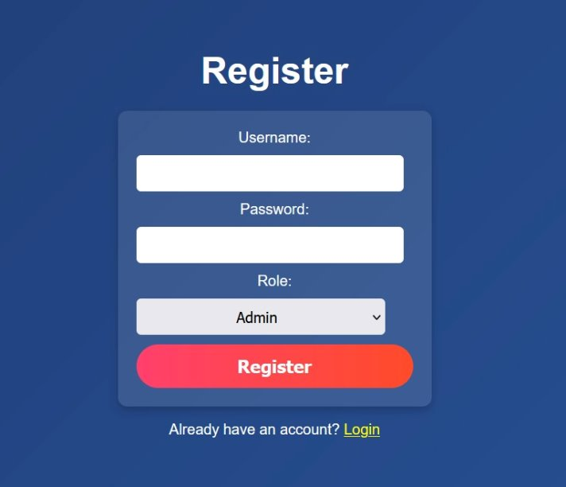
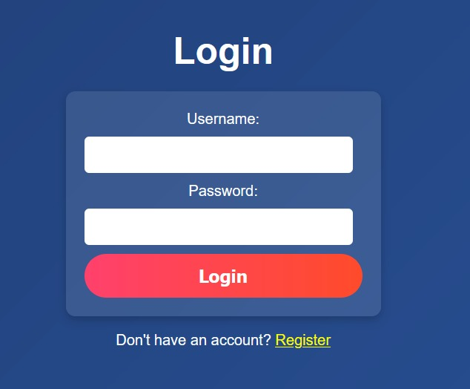
Description: This is the Welcome Page of the Online Exam Proctoring System. It gives users two options: Login and Register
Welcome To Online Exam System
Description: This is the Registration Page where users can create an account.
Description: Here is the Login Page where users enter credentials.
Registration Page for Admin
Login Page for Admin

Slide 16
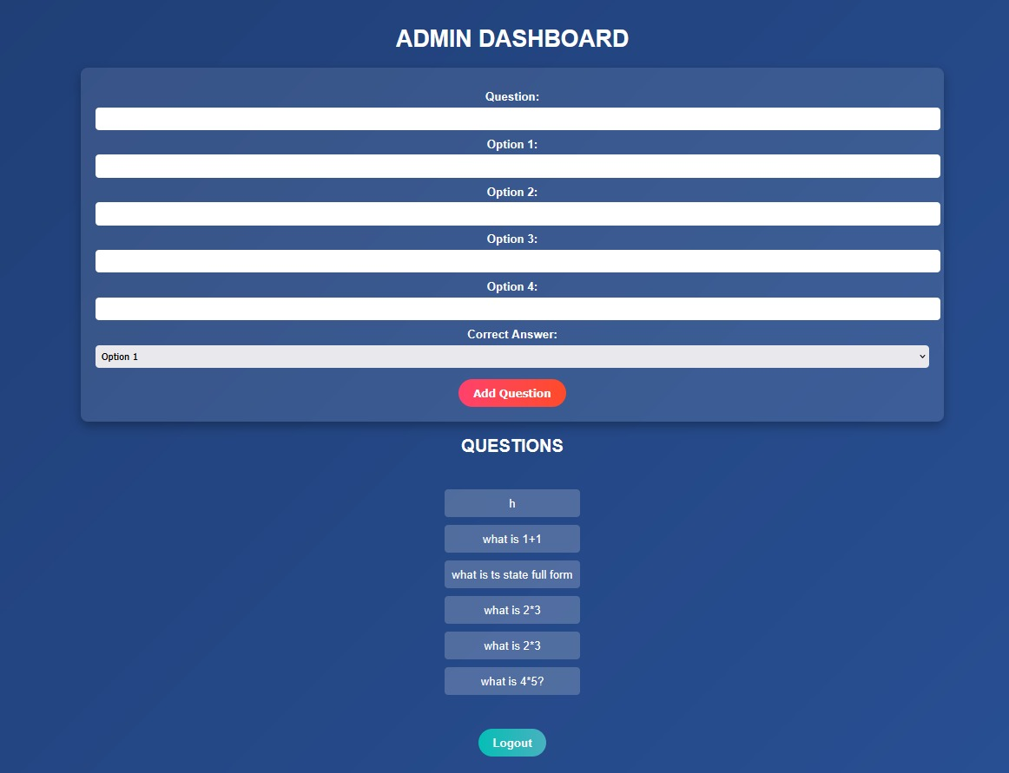
Description: Admins can add questions by filling in a form with question text, four options, and the correct answer.
Admin Dashboard Page

Slide 17
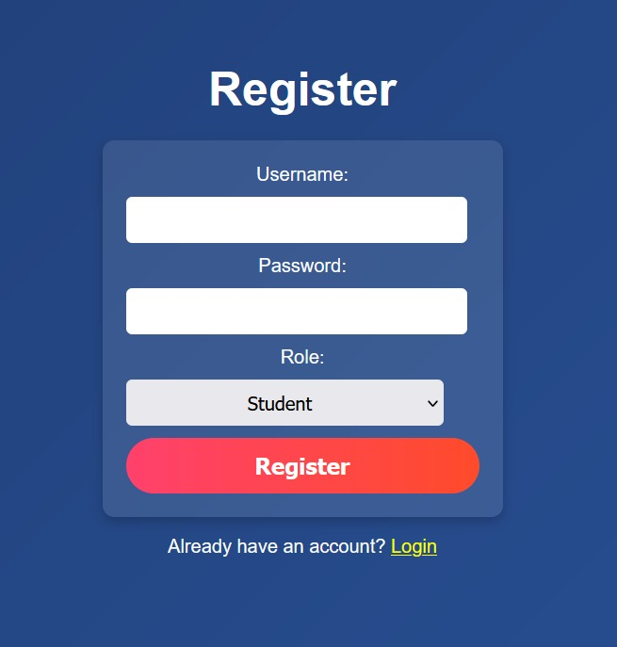
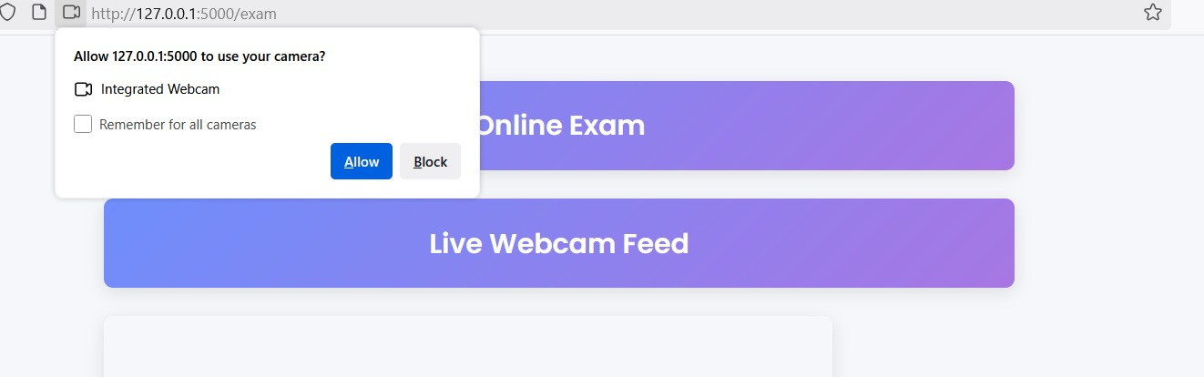
Description: New users can register by entering a Username, Password, selecting a Role (Admin/Student).
Description: Registered users enter their credentials to log in.
Registration Page for Student
Login Page for Student
Description: The browser prompts the user to allow access to the webcam (127.0.0.1:5000 is your local server)
Camera Permission Request

Slide 18
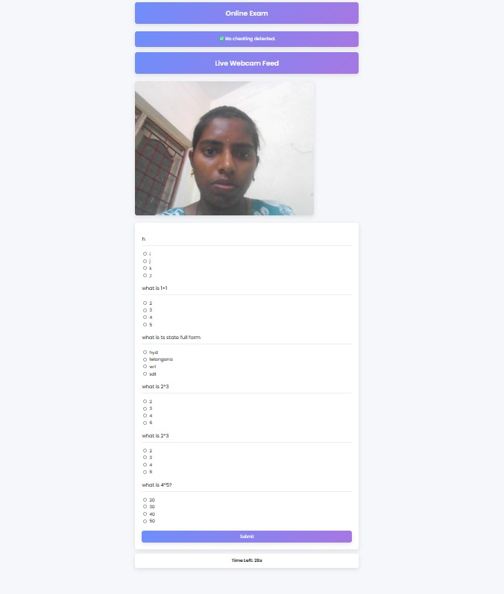
Description: This is the main exam page where the student answers questions while being monitored live through their webcam.
Online Exam Page

Slide 19
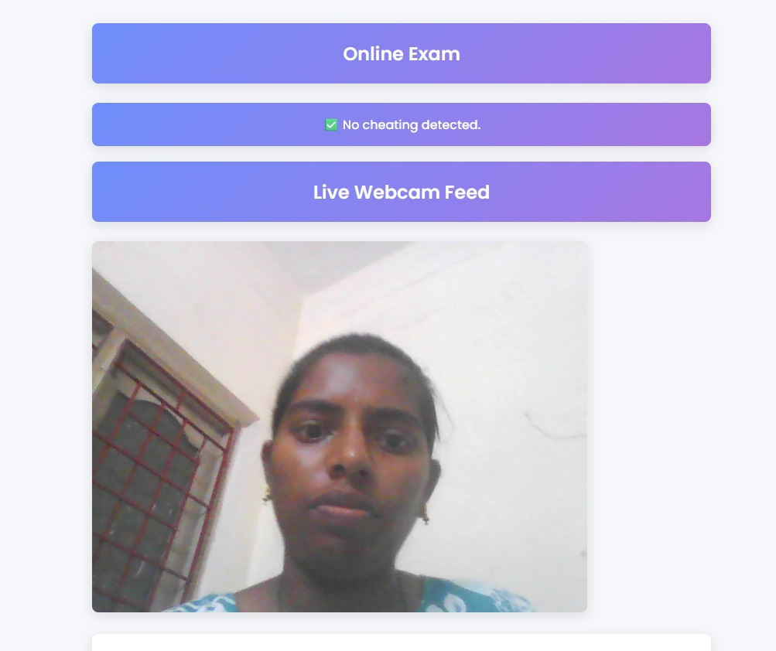
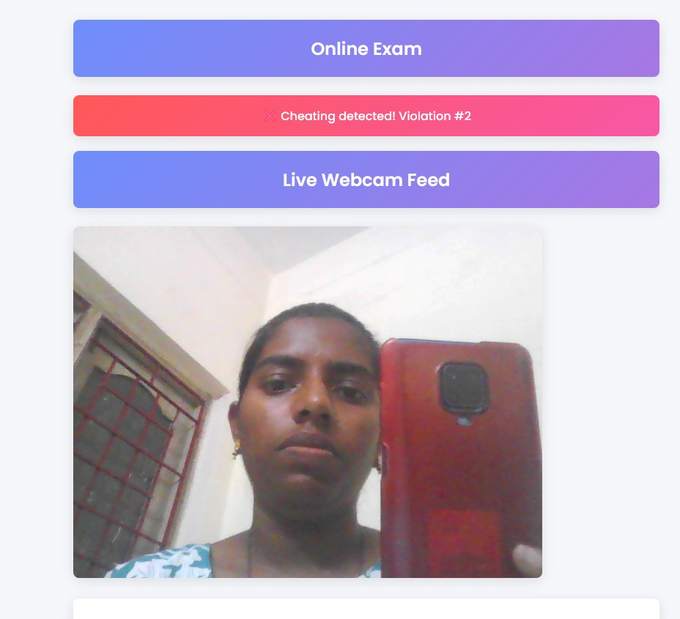
Description: The live webcam feed shows one person (the examinee) looking at the screen.
Description: The examinee is holding up a mobile phone in front of the webcam Cheating detected!
No Cheating Detected Page
Cheating Detected Page

Slide 20
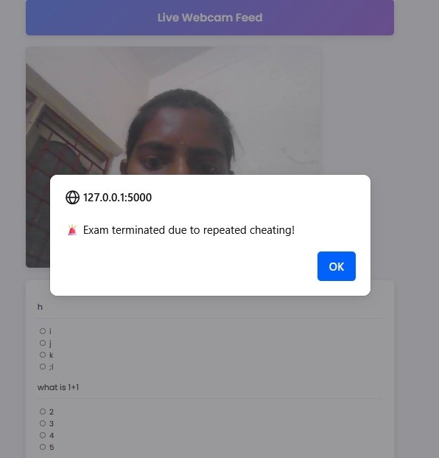
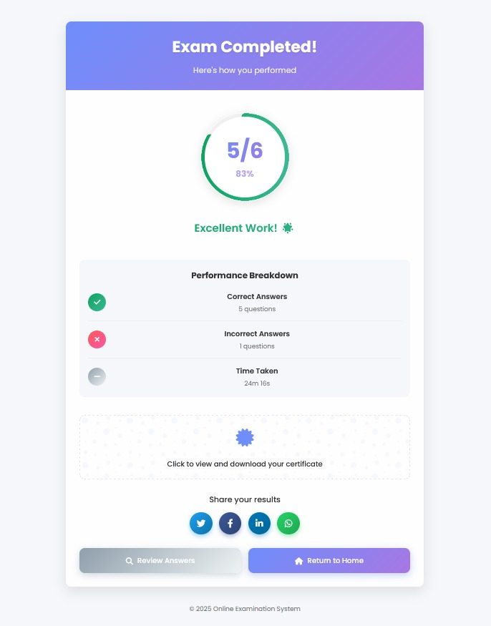
Description: Alert message after repeated cheating detected by the system
Description: This page appears after the exam is submitted. It also displays the student’s score.
Exam Termination Alert
Exam Completed Page

Slide 21
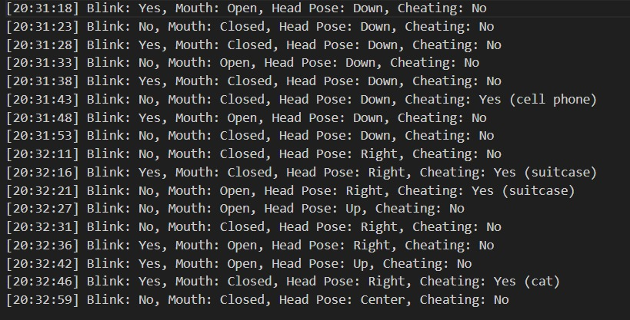
Description: This is a text-based report file generated automatically for each student during the exam.
Cheating Detection Log in Report Folder

Slide 22
CONCLUSION
The AI-based Online Exam Proctoring System ensures secure and fair online exams by using real-time monitoring modules like blink detection, mouth tracking, head pose estimation, and object detection.
Built with lightweight tools like Flask and SQLite, it automatically detects cheating and ends exams on repeated violations. The system is user-friendly, scalable, and protects privacy, making it a practical solution for modern online education.

Slide 23
REFERENCES
1.Dendir, S., & Maxwell, R. S., "Cheating in online courses: Evidence from online proctoring", Computers in Human Behavior Reports, vol. 2, pp. 100033, 2020, doi: 10.1016/j.chbr.2020.100033.
2.P. Gupta and A. Bansal, "Face and Eye Detection using MediaPipe in Real-Time Applications", in International Conference on Machine Vision, vol. 9, pp. 78–85, 2022. doi:10.1109/ICMV.2022.00019.
3.J. Mathew and D. Roy, "Integration of YOLOv5 for Mobile Phone Detection in Exam Proctoring", in Computer Vision and Applications Journal, vol. 6, no. 4, pp. 134–142, 2023. doi:10.1016/cvaj.2023.06.007.

Slide 24


